Slide 1
VALIDATION
Notes:
In this supplementary training module, we will be looking at the recommendations by WHO, on Validation and qualification.
The module consists of 7 parts:
Part 1. General overview on qualification and validation
Part 2. Qualification of HVAC and water systems
Part 3. Cleaning validation
Part 4. Analytical method validation
Part 5. Computerized system validation
Part 6. Qualification of systems and equipment
Part 7. Non sterile product process validation
Each part deals with a specific topic, and each part can be presented in about one to one and a half hours time. Presenters should know the topics and add practical examples to the texts taken from the WHO guideline.

Slide 2
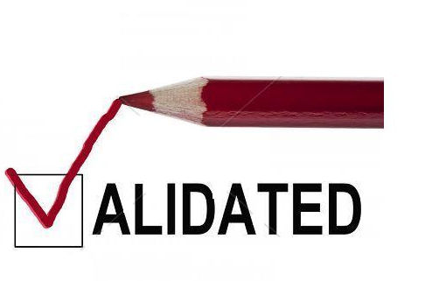

Slide 3
Validation
Validation is an essential part of GMP, and an element of QA
Basic principles include:
Safety, quality and efficacy of products
Built into the product – as it cannot be "inspected or tested into a product"
Critical steps in the process need to be validated
Need for confidence that the product will consistently meet predetermined specifications and attributes
Notes:
1. Introduction
Validation is an essential part of good manufacturing practices (GMP). It is,
therefore, an element of the quality assurance programme associated with a
particular product or process. The basic principles of quality assurance have
as their goal the production of products that are fi t for their intended use.
These principles are as follows:
• Quality, safety and effi cacy must be designed and built into the product.
• Quality cannot be inspected or tested into the product.
• Each critical step of the manufacturing process must be validated. Other
steps in the process must be under control to maximize the probability
that the fi nished product consistently and predictably meets all quality
and design specifi cations.
Validation of processes and systems is fundamental to achieving these goals.
It is by design and validation that a manufacturer can establish confi dence that
the manufactured products will consistently meet their product specifi cations.

Slide 4
Validation
Documentation associated with validation:
SOPs
Specifications
Validation Master Plan (VMP)
Qualification protocols and reports
Validation protocols and reports
Notes:
Documentation associated with validation includes:
— standard operating procedures (SOPs)
— Specifications
— Validation master plan (VMP)
— Qualification protocols and reports
— Validation protocols and reports.

Slide 5
Validation
Validation work requires considerable resources such as:
Time:
work is subject to rigorous time schedules
Money:
may need specialized personnel and expensive technology
People:
collaboration of experts from various disciplines
a multidisciplinary team, comprising quality assurance, engineering, production, quality control (other disciplines, depending on the product and process to be validated)
Notes:
The implementation of validation work requires considerable resources such as:
• Time: generally validation work is subject to rigorous time schedules.
• Financial: validation often requires the time of specialized personnel and
expensive technology.
• Human: validation requires the collaboration of experts from various disciplines
(e.g. a multidisciplinary team, comprising quality assurance, engineering,
manufacturing and other disciplines, depending on the product
and process to be validated).

Slide 6
DEFINITION-
Validation is a key process for effective quality assurance.
“Validation is establishing documented evidence which provides a high degree of assurance that a specific process or equipment will consistently produce a product or result meeting its predetermined specifications and quality attributes.”

Slide 7
The major reasons for validation are:
Quality assurance:
Validation checks the accuracy and reliability of a system or a process to meet the predetermined criteria. A successful validation provides high degree of assurance that a consistent level of quality is maintained in each unit of the finished product from one batch to another batch.
Economics:
Due to successful validation, there is a decrease in sampling and testing procedures and there are less number of product rejections and retesting. This leads to cost-saving benefits.

Slide 8
Compliance:
For compliance to current good manufacturing practices, validation is essential.

Slide 9
Validation
Qualification and Validation
Qualification and validation are essentially components of the same concept
The term qualification is normally used for equipment, utilities and systems
The term validation is normally used for processes
In this sense, qualification is part of validation
Notes:
4. Relationship between validation and qualification
Validation and qualification are essentially components of the same concept.
The term qualification is normally used for equipment, utilities and systems,
and validation for processes. In this sense, qualification is part of validation.

Slide 10
Validation
Validation: Approaches to validation
Two basic approaches:
Evidence obtained through testing (prospective and concurrent validation), and
Analysis of accumulated (historical) data (retrospective validation)
Whenever possible, prospective validation is preferred.
Retrospective validation is no longer encouraged
Retrospective validation is not applicable to sterile products
Notes:
5. Validation
5.1 Approaches to validation
5.1.1 There are two basic approaches to validation — one based on evidence
obtained through testing (prospective and concurrent validation), and
one based on the analysis of accumulated (historical) data (retrospective
validation). Whenever possible, prospective validation is preferred. Retrospective
validation is no longer encouraged and is, in any case, not applicable
to the manufacturing of sterile products.

Slide 11
Type of Process Validation-
Prospective validation:
-Conducted prior to market the product.
- Documented evidence which provides a high degree of assurances that a specific process or equipment will consistently produce a product meeting its predetermined specifications and quality attributes.
Concurrent validation:
Based on information generated during actual implementation of the process.
Establishing documented evidence that the process is in a state of control during the actual implementation of the process. This normally performed by conducting in- process testing.

Slide 12
Retrospective validation:
All the processes and subsystems should be validated ,which have been used for the production of batches of numerical data of both process and the end product testing of which are included in retrospective validation.

Slide 13
Validation
Validation: Approaches to validation (2)
Both prospective and concurrent validation, may include:
extensive product testing, which may involve extensive sample testing (with the estimation of confidence limits for individual results) and the demonstration of intra- and inter-batch homogeneity;
simulation process trials;
challenge/worst case tests, which determine the robustness of the process; and
control of process parameters being monitored during normal production runs to obtain additional information on the reliability of the process.
Notes:
5.1.2 Both prospective and concurrent validation, may include:
• extensive product testing, which may involve extensive sample testing
(with the estimation of confidence limits for individual results) and the
demonstration of intra- and inter-batch homogeneity;
• simulation process trials;
• challenge/worst case tests, which determine the robustness of the process;
and
• control of process parameters being monitored during normal production
runs to obtain additional information on the reliability of the process.

Slide 14
Validation
Scope of validation
Validation requires an appropriate and sufficient infrastructure including:
organization, documentation, personnel and finances
Involvement of management and quality assurance personnel
Personnel with appropriate qualifications and experience
Extensive preparation and planning before validation is performed
A specific programme for validation activities in place
Validation done in a structured way according to documentation including procedures and protocols.
Notes:
5.2 Scope of validation
5.2.1 There should be an appropriate and suffi cient system including organizational
structure and documentation infrastructure, suffi cient personnel
and fi nancial resources to perform validation tasks in a timely manner. Management
and persons responsible for quality assurance should be involved.
5.2.2 Personnel with appropriate qualifications and experience should
be responsible for performing validation. They should represent different
departments depending on the validation work to be performed.
5.2.3 There should be proper preparation and planning before validation is
performed. There should be a specifi c programme for validation activities.

Slide 15
Validation
Scope of validation
Validation should be performed:
for new premises, equipment, utilities and systems, and processes and procedures;
at periodic intervals; and
when major changes have been made.
Validation in accordance with written protocols.
A written report on the outcome to be produced.
Validation over a period of time, e.g.
at least three consecutive batches (full production scale) to demonstrate consistency. (Worst case situations should be considered.)
Notes:
5.2.5 Validation should be performed:
— for new premises, equipment, utilities and systems, and processes and
procedures;
— at periodic intervals; and
— when major changes have been made.
(Periodic revalidation or periodic requalification may be substituted, where
appropriate, with periodic evaluation of data and information to establish
whether requalification or revalidation is required.)
5.2.6 Validation should be performed in accordance with written protocols.
A written report on the outcome of the validation should be produced.
5.2.7 Validation should be done over a period of time, e.g. at least three
consecutive batches (full production scale) should be validated, to demonstrate
consistency. Worst case situations should be considered.

Slide 16
Validation
Scope of validation
Distinction between in-process controls and validation
In-process tests (performed during the manufacture of each batch; their objective is to monitor the process continuously)
Demonstrate suitability for new manufacturing formula or method
Process, materials and equipment to prove consistent yield of a product of the required quality
Manufacturers to identify what validation work is needed
Significant changes (facilities, equipment, processes) - should be validated
Risk assessment approach used to determine the scope and extent of validation needed
Notes:
5.2.8 There should be a clear distinction between in-process controls and
validation. In-process tests are performed during the manufacture of each
batch according to specifi cations and methods devised during the development
phase. Their objective is to monitor the process continuously.
5.2.9 When a new manufacturing formula or method is adopted, steps
should be taken to demonstrate its suitability for routine processing. The
defi ned process, using the materials and equipment specifi ed, should
be shown to result in the consistent yield of a product of the required
quality.
5.2.10 Manufacturers should identify what validation work is needed to
prove that critical aspects of their operations are appropriately controlled.
Signifi cant changes to the facilities or the equipment, and processes that
may affect the quality of the product should be validated. A risk assessment
approach should be used to determine the scope and extent of validation
required.

Slide 17
Validation
Qualification
Qualification should be completed before process validation is performed
A logical, systematic process followed
Start from the design phase of the premises, equipment, utilities and equipment
Major equipment and critical utilities and systems normally require IQ, OQ and PQ
Notes:
6. qualification
6.1 qualification should be completed before process validation is performed.
The process of qualification should be a logical, systematic process
and should start from the design phase of the premises, equipment, utilities
and equipment.

Slide 18
Validation
Qualification
Some equipment, utilities and systems require only IQ and OQ as the correct operation could be considered to be a sufficient indicator of its performance
The equipment, utility and system should then be maintained, monitored and calibrated according to a regular schedule
Notes:
6.2 Depending on the function and operation of the equipment, utility
or system, only installation qualification (IQ) and operational qualification
(OQ) may be required, as the correct operation of the equipment, utility or
system could be considered to be a suffi cient indicator of its performance
(refer to Section 11 for IQ, OQ and performance qualification (PQ)). (The
equipment, utility and system should then be maintained, monitored and
calibrated according to a regular schedule.)

Slide 19
Validation
Calibration: The set of operations that establish, under specified conditions, the relationship between values indicated by an instrument or system for measuring (for example, weight, temperature and pH), recording and controlling, or the values represented by a material measure, and the corresponding known values of a reference standard. Limits for acceptance of the results of measuring should be established.
Notes:
It is important that you read the guidelines and familiarize yourself with the terms and definitions in the Glossary part. You should know what the terms mean, and also the differences between different concepts including calibration and qualification.

Slide 20
Validation
Calibration and verification
Performed at regular intervals
Responsible personnel with appropriate qualifications and training
Calibration programme available including information, e.g.
calibration standards and limits, responsible persons, calibration intervals, records and actions to be taken when necessary
Notes:
7. Calibration and verifi cation
7.1 Calibration and verifi cation of equipment, instruments and other
devices, as applicable, used in production and quality control, should be
performed at regular intervals.
7.2 Personnel who carry out calibration and preventive maintenance
should have appropriate qualifications and training.
7.3 A calibration programme should be available and should provide information
such as calibration standards and limits, responsible persons, calibration
intervals, records and actions to be taken when problems are identifi ed.

Slide 21
Validation
Calibration and verification
Traceability to standards used
(e.g. national, regional or international standards)
Calibrated equipment, instruments and other devices to be labelled, coded or otherwise identified
indicate status of calibration and recalibration due date
If not used for a certain period of time
function and calibration status to be verified
shown to be satisfactory before use
Notes:
7.4 There should be traceability to standards (e.g. national, regional or
international standards) used in the calibration.
7.5 Calibrated equipment, instruments and other devices should be labelled,
coded or otherwise identifi ed to indicate the status of calibration and
the date on which recalibration is due.
7.6 When the equipment, instruments and other devices have not been
used for a certain period of time, their function and calibration status should
be verifi ed and shown to be satisfactory before use.

Slide 22
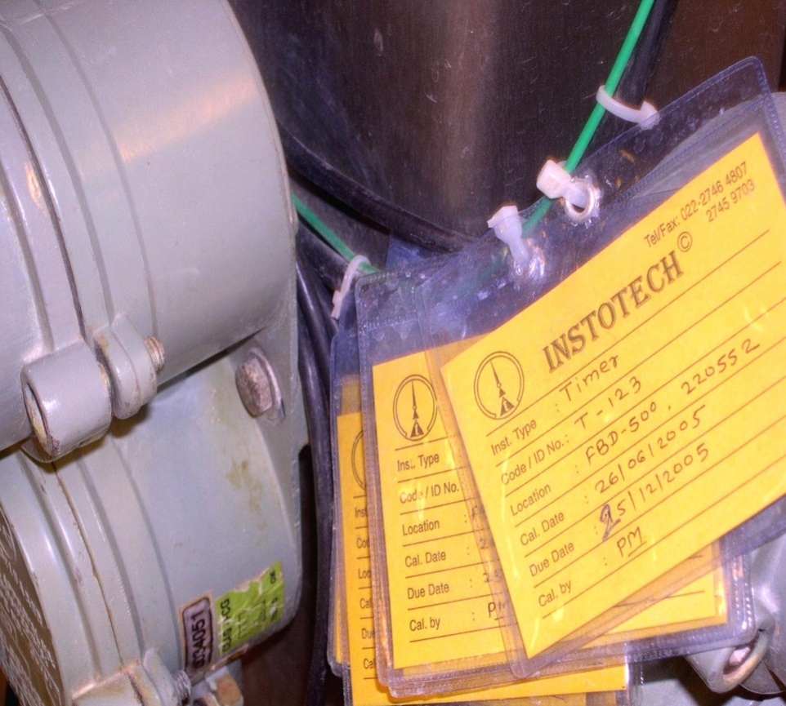
Validation
Suitable labels indicate calibration status
Traceability, e.g.
Instrument
Date
Personnel
Standard
Range and conditions as appropriate

Slide 23
Validation
Documentation
Validation Master Plan (VMP)
Protocols
Reports
SOPs
Others?
Notes:
The trainer should explain briefly which types of documents are associated or needed as part of a validation/qualification exercise. Explain that some of these will be discussed in detail in the following slides

Slide 24
Validation
Validation Master Plan (VMP)
Contains key elements of the validation programme.
Concise, clear, contain at least:
a validation policy
organizational structure of validation activities
summary of facilities, systems, equipment and processes validated (and to be validated)
documentation format (e.g. protocol and report)
planning and scheduling
change control and references to existing documents
Notes:
8. Validation master plan
The validation master plan (VMP) should refl ect the key elements of the
validation programme. It should be concise and clear and contain at least
the following:
— a validation policy
— organizational structure of validation activities
— summary of facilities, systems, equipment and processes validated and
to be validated
— documentation format (e.g. protocol and report format)
— planning and scheduling
— change control
— references to existing documents.

Slide 25
Validation
Qualification and validation protocols
Describe the study to be performed and include as a minimum:
the objectives of the study
the site of the study
the responsible personnel
description of SOPs to be followed
equipment to be used
standards and criteria for the products and processes
the type of validation
Notes:
9. qualification and validation protocols
9.1 There should be qualification and validation protocols describing
the qualification and validation study to be performed.
9.2 As a minimum the protocols should include the following signifi cant
background information:
— the objectives of the study
— the site of the study
— the responsible personnel
— description of SOPs to be followed
— equipment to be used; standards and criteria for the relevant products
and processes
— the type of validation
— the processes and/or parameters
— sampling, testing and monitoring requirements
— predetermined acceptance criteria for drawing conclusions.
9.3 There should be a description of the way in which the results will be
analysed.
9.4 The protocol should be approved prior to use. Any changes to a protocol
should be approved prior to implementation of the change.

Slide 26
Validation
Qualification and validation protocols (2)
Protocol contents (2):
the processes and/or parameters
sampling, testing and monitoring requirements
predetermined acceptance criteria for drawing conclusions
Description (how results will be analysed)
Protocol approved prior to use - changes approved prior to implementation of the change
Notes:
9.2 As a minimum the protocols should include the following signifi cant
background information:
— the processes and/or parameters
— sampling, testing and monitoring requirements
— predetermined acceptance criteria for drawing conclusions.
9.3 There should be a description of the way in which the results will be
analysed.
9.4 The protocol should be approved prior to use. Any changes to a protocol
should be approved prior to implementation of the change.

Slide 27
Validation
Qualification and validation reports
Written reports on the qualification and validation performed
Reflect protocols followed and include at least:
title and objective of the study; reference to the protocol; details of material
equipment, programmes and cycles used; procedures and test methods
Results evaluated, analysed and compared against the pre-determined acceptance criteria
Notes:
10. Qualification and validation reports
10.1 There should be written reports on the qualification and validation
performed.
10.2 Reports should refl ect the protocols followed and include at least the
title and objective of the study; reference to the protocol; details of material,
equipment, programmes and cycles used; procedures and test methods.
10.3 The results should be evaluated, analysed and compared against the
pre-determined acceptance criteria. The results should meet the acceptance
criteria; deviations and out-of-limit results should be investigated. If these
deviations are accepted, this should be justifi ed. Where necessary further
studies should be performed.
10.4 The departments responsible for the qualification and validation
work should approve the completed report.
10.5 The conclusion of the report should state whether or not the outcome
of the qualification and/or validation was considered successful.
116
10.6 The quality assurance department should approve the report after
the fi nal review. The criteria for approval should be in accordance with the
company’s quality assurance system.
10.7 Any deviations found during the validation process should be acted
upon and documented as such. Corrective actions may be required.

Slide 28
Validation
Qualification and validation reports (2)
The results should meet the acceptance criteria
Deviations and out-of-limit results should be investigated. If these are accepted, this should be justified. Where necessary further studies should be performed
Responsible departments and QA to approve completed report, including the conclusion
Notes:
10.3 The results should be evaluated, analysed and compared against the
pre-determined acceptance criteria. The results should meet the acceptance
criteria; deviations and out-of-limit results should be investigated. If these
deviations are accepted, this should be justifi ed. Where necessary further
studies should be performed.
10.4 The departments responsible for the qualification and validation
work should approve the completed report.
10.5 The conclusion of the report should state whether or not the outcome
of the qualification and/or validation was considered successful.
116
10.6 The quality assurance department should approve the report after
the fi nal review. The criteria for approval should be in accordance with the
company’s quality assurance system.
10.7 Any deviations found during the validation process should be acted
upon and documented as such. Corrective actions may be required.

Slide 29
Validation
Qualification stages
There are four stages of qualification:
design qualification (DQ);
installation qualification (IQ);
operational qualification (OQ); and
performance qualification (PQ).
All SOPs for operation, maintenance and calibration should be prepared during qualification
Training provided and records maintained
Notes:
11. qualification stages
11.1 There are four stages of qualification:
— design qualification (DQ);
— installation qualification (IQ);
— operational qualification (OQ); and
— performance qualification (PQ).
11.2 All SOPs for operation, maintenance and calibration should be
prepared during qualification.
11.3. Training should be provided to operators and training records should
be maintained.

Slide 30
Validation
Design qualification: Provides documented evidence that the design specifications were met
Installation qualification: Provides documented evidence that the installation was complete and satisfactory
During IQ:
Purchase specifications, drawings, manuals, spare parts lists and vendor details should be verified
Control and measuring devices should be calibrated
Notes:
Design qualification
11.4 Design qualification should provide documented evidence that the
design specifi cations were met.
Installation qualification
11.5 Installation qualification should provide documented evidence that
the installation was complete and satisfactory.
11.6 The purchase specifi cations, drawings, manuals, spare parts lists and
vendor details should be verifi ed during installation qualification.
11.7 Control and measuring devices should be calibrated.

Slide 31
Validation
Operational qualification: Provides documented evidence that utilities, systems or equipment and all its components operate in accordance with operational specifications
Demonstrate satisfactory operation over the normal operating range as well as at the limits of its operating conditions (including worst case conditions)
Operation controls, alarms, switches, displays and other operational components should be tested
Notes:
Operational qualification
11.8 Operational qualification should provide documented evidence that
utilities, systems or equipment and all its components operate in accordance
with operational specifi cations.
11.9 Tests should be designed to demonstrate satisfactory operation over
the normal operating range as well as at the limits of its operating conditions
(including worst case conditions).
11.10 Operation controls, alarms, switches, displays and other operational
components should be tested.
11.11 Measurements made in accordance with a statistical approach should
be fully described.

Slide 32
Validation
Performance qualification: Provides documented evidence that utilities, systems or equipment and all its components can consistently perform in accordance with the specifications under routine use
Test results collected over a suitable period of time to prove consistency
Notes:
Performance qualification
11.12 Performance qualification should provide documented evidence that
utilities, systems or equipment and all its components can consistently perform
in accordance with the specifi cations under routine use.
11.13 Test results should be collected over a suitable period of time to
prove consistency.

Slide 33
Validation
Requalification
In accordance with a defined schedule
Frequency to be determined (e.g. on the basis of factors such as the analysis of results relating to calibration, verification and maintenance)
Periodic and after changes
e.g. changes to utilities, systems, equipment; maintenance work; and movement
Part of change control procedure
Notes:
requalification
11.14 requalification should be done in accordance with a defi ned schedule.
The frequency of requalification may be determined on the basis of factors such
as the analysis of results relating to calibration, verifi cation and maintenance.
11.15 There should be periodic requalification, as well as requalification
after changes (such as changes to utilities, systems, equipment; maintenance
work; and movement). (See also point 5.2.5 above and section 12 below.)
11.16 requalification should be considered as part of the change control
procedure.
Revalidation
11.17 Processes and procedures should be revalidated to ensure that they
remain capable of achieving the intended results.
11.18 There should be periodic revalidation, as well as revalidation after
changes. (See also points 5.2.5 above, point 11.21 below and section 12 below.)
11.19 Revalidation should be done in accordance with a defi ned schedule.
11.20 The frequency and extent of revalidation should be determined
using a risk-based approach together with a review of historical data.

Slide 34
Validation
Revalidation
Processes and procedures - to ensure that they remain capable of achieving the intended results
Periodic revalidation, as well as revalidation after changes
In accordance with a defined schedule
Frequency and extent determined using a risk-based approach together with a review of historical data
Notes:
Revalidation
11.17 Processes and procedures should be revalidated to ensure that they
remain capable of achieving the intended results.
11.18 There should be periodic revalidation, as well as revalidation after
changes. (See also points 5.2.5 above, point 11.21 below and section 12 below.)
11.19 Revalidation should be done in accordance with a defi ned schedule.
11.20 The frequency and extent of revalidation should be determined
using a risk-based approach together with a review of historical data.

Slide 35
Validation
Periodic revalidation
To assess process changes that may occur gradually over a period of time, or because of wear of equipment
Consideration given to:
master formulae and specifications
SOPs
records (e.g. of calibration, maintenance and cleaning)
analytical methods
Notes:
Periodic revalidation
11.21 Periodic revalidation should be performed to assess process changes that
may occur gradually over a period of time, or because of wear of equipment.
11.22 The following should be considered when periodic revalidation is
performed:
— master formulae and specifi cations;
— SOPs;
— records (e.g. of calibration, maintenance and cleaning); and
— analytical methods.

Slide 36
Validation
Revalidation after change
After change that could have an effect on the process, procedure, quality of the product and/or the product characteristics. (Considered as part of the change control procedure.)
Extent depends on the nature and significance of the change(s)
Changes should not adversely affect product quality or process characteristics
Notes:
Revalidation after change
11.23 Revalidation should be performed following a change that could
have an effect on the process, procedure, quality of the product and/or the
product characteristics. Revalidation should be considered as part of the
change control procedure.
11.24 The extent of revalidation will depend on the nature and signifi cance
of the change(s).
11.25 Changes should not adversely affect product quality or process
characteristics.
11.26 Changes requiring revalidation should be defi ned in the validation
plan and may include:
• changes in starting materials (including physical properties, such as density,
viscosity or particle size distribution that may affect the process or product);
• change of starting material manufacturer;
• transfer of processes to a different site (including change of facilities and
installations which infl uence the process);
• changes of primary packaging material (e.g. substituting plastic for glass);
• changes in the manufacturing process (e.g. mixing times or drying temperatures);
• changes in the equipment (e.g. addition of automatic detection systems,
installation of new equipment, major revisions to machinery or apparatus
and breakdowns);
• production area and support system changes (e.g. rearrangement of areas,
or a new water treatment method);
• appearance of negative quality trends;
• appearance of new fi ndings based on current knowledge, e.g. new technology;
• support system changes.
Changes of equipment which involve the replacement of equipment on a
“like-for-like” basis would not normally require a revalidation. For example,
installation of a new centrifugal pump to replace an older model would
not necessarily require revalidation.

Slide 37
Validation
Changes requiring revalidation should be defined in the validation plan and may include:
changes in starting materials
change of starting material manufacturer
transfer of processes to a different site
changes of primary packaging material
changes in the manufacturing process
changes in the equipment
production area and support system changes
appearance of negative quality trends
appearance of new findings based on current knowledge
support system changes
e.g. including physical properties, such as density, viscosity or particle size distribution that may affect the process or product
e.g. change of facilities and installations which influence the process
e.g. substituting plastic for glass
e.g. mixing times or drying temperatures
e.g. addition of automatic detection systems, installation of new equipment, major revisions to machinery or apparatus and breakdowns
e.g. rearrangement of areas, or a new water treatment method
e.g. new technology
Notes:
Revalidation after change
11.23 Revalidation should be performed following a change that could
have an effect on the process, procedure, quality of the product and/or the
product characteristics. Revalidation should be considered as part of the
change control procedure.
11.24 The extent of revalidation will depend on the nature and signifi cance
of the change(s).
11.25 Changes should not adversely affect product quality or process
characteristics.
11.26 Changes requiring revalidation should be defi ned in the validation
plan and may include:
• changes in starting materials (including physical properties, such as density,
viscosity or particle size distribution that may affect the process or product);
• change of starting material manufacturer;
• transfer of processes to a different site (including change of facilities and
installations which infl uence the process);
• changes of primary packaging material (e.g. substituting plastic for glass);
• changes in the manufacturing process (e.g. mixing times or drying temperatures);
• changes in the equipment (e.g. addition of automatic detection systems,
installation of new equipment, major revisions to machinery or apparatus
and breakdowns);
• production area and support system changes (e.g. rearrangement of areas,
or a new water treatment method);
• appearance of negative quality trends;
• appearance of new fi ndings based on current knowledge, e.g. new technology;
• support system changes.

Slide 38
Validation
Revalidation after change (continuation)
Changes of equipment which involve the replacement of equipment on a “like-for-like” basis would not normally require a revalidation
For example, installation of a new centrifugal pump to replace an older model would not necessarily require revalidation
Notes:
Revalidation after change
11.23 Revalidation should be performed following a change that could
have an effect on the process, procedure, quality of the product and/or the
product characteristics. Revalidation should be considered as part of the
change control procedure.
11.24 The extent of revalidation will depend on the nature and signifi cance
of the change(s).
11.25 Changes should not adversely affect product quality or process
characteristics.
11.26 Changes requiring revalidation should be defi ned in the validation
plan and may include:
• changes in starting materials (including physical properties, such as density,
viscosity or particle size distribution that may affect the process or product);
• change of starting material manufacturer;
• transfer of processes to a different site (including change of facilities and
installations which infl uence the process);
• changes of primary packaging material (e.g. substituting plastic for glass);
• changes in the manufacturing process (e.g. mixing times or drying temperatures);
• changes in the equipment (e.g. addition of automatic detection systems,
installation of new equipment, major revisions to machinery or apparatus
and breakdowns);
• production area and support system changes (e.g. rearrangement of areas,
or a new water treatment method);
• appearance of negative quality trends;
• appearance of new fi ndings based on current knowledge, e.g. new technology;
• support system changes.
Changes of equipment which involve the replacement of equipment on a
“like-for-like” basis would not normally require a revalidation. For example,
installation of a new centrifugal pump to replace an older model would
not necessarily require revalidation.

Slide 39
Validation
Change control
SOP followed - as changes may have an impact on a qualified utility, system or piece of equipment, and a validated process and/or procedure
Describe the actions to be taken, including the need for and extent of qualification or validation
Changes should be formally requested, documented and approved before implementation
Records should be maintained
Notes:
12. Change control
12.1 Changes should be controlled in accordance with a SOP as changes
may have an impact on a qualifi ed utility, system or piece of equipment, and
a validated process and/or procedure.
12.2 The procedure should describe the actions to be taken, including the
need for and extent of qualifi cation or validation to be done.
12.3 Changes should be formally requested, documented and approved
before implementation. Records should be maintained.

Slide 40
Validation
Personnel
Demonstrate that personnel are appropriately qualified, where relevant
These include for example:
laboratory analysts;
personnel following critical procedures;
personnel doing data entry in computerized systems; and
risk assessors.
Notes:
13. Personnel
13.1 Personnel should demonstrate that they are appropriately qualifi ed,
where relevant.
13.2 Personnel requiring qualifi cation include, for example:
— laboratory analysts;
— personnel following critical procedures;
— personnel doing data entry in computerized systems; and
— risk assessors.

